Slide 1
5 selfish reasons to work reproducibly
More publications, more grants, more awesome!

Slide 2
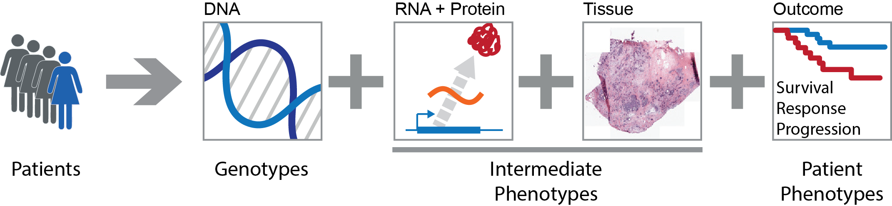
Systems Genetics of Cancer
Genetic variation
In people
In tumours
In clones
Phenotypic variation
Tumour subtypes
Aggressiveness
Survival

Slide 3
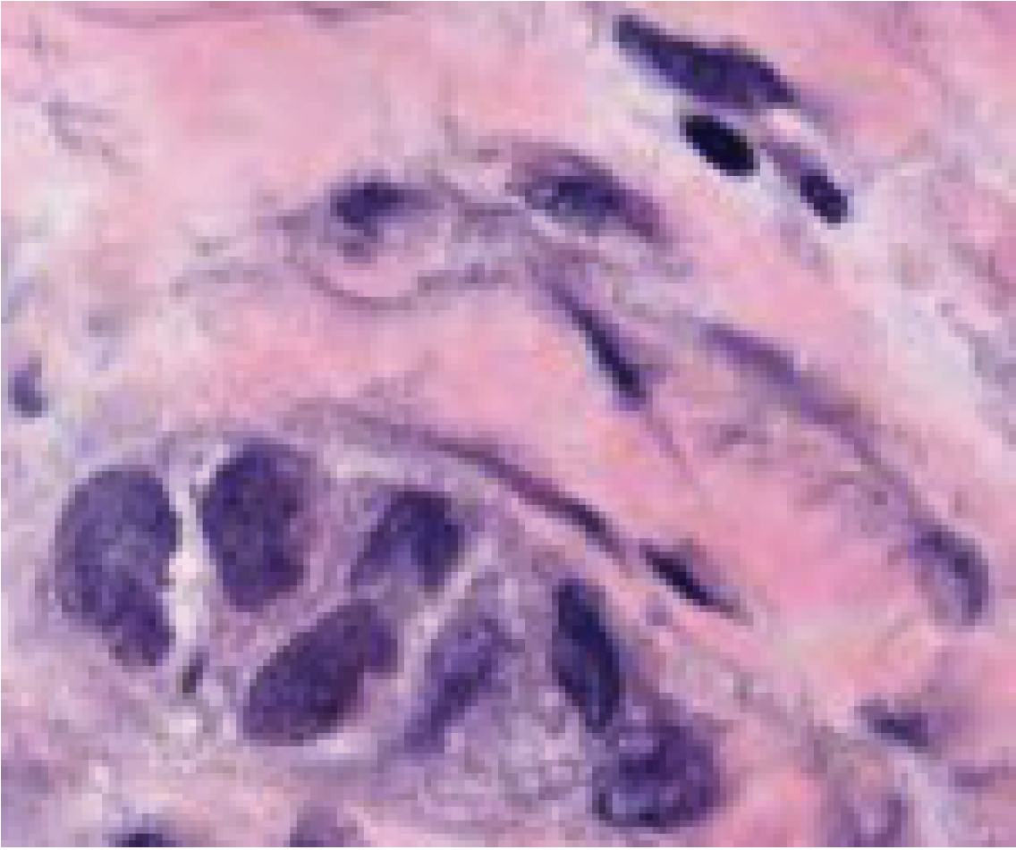



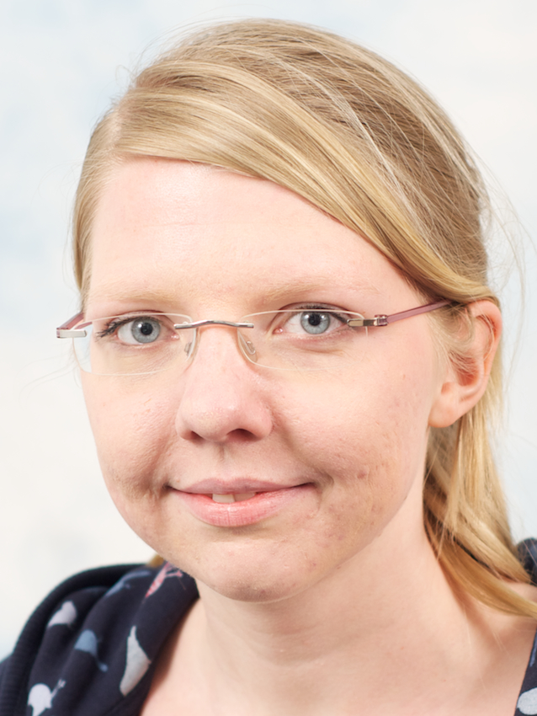
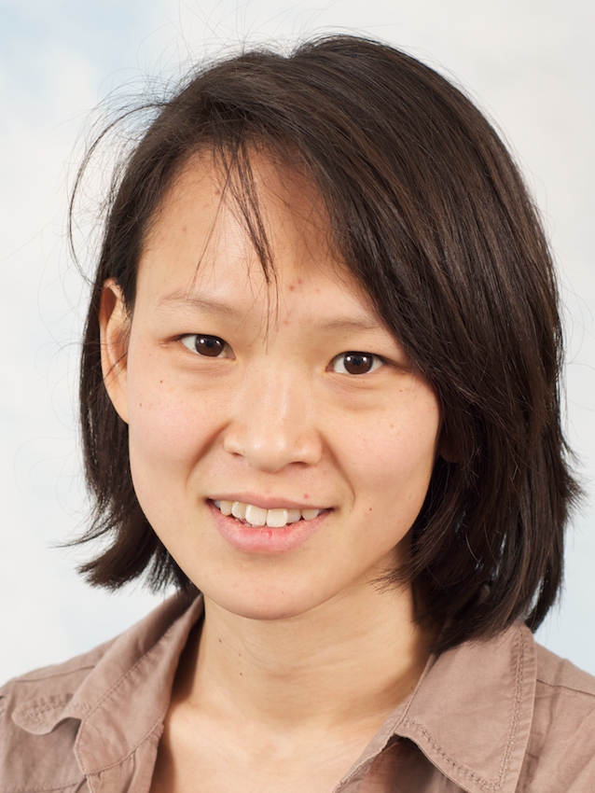





Cancer genome
Function
Cancer genome
Evolution
Cancer tissue
Context
Andy
Wei
Ke
Edith
Anne
Joe
Amanda
Ines
Geoff
Leon

Slide 4
A project is more
than a beautiful result!

Slide 5
Reproducibility
starts early!

Slide 6
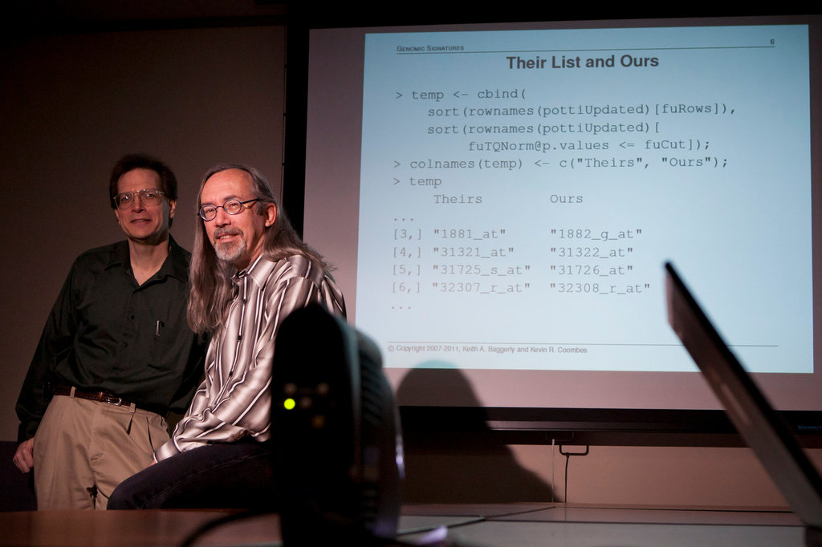
“How Bright Promise in Cancer Testing Fell Apart” New York Times, July 7, 2011

Slide 7
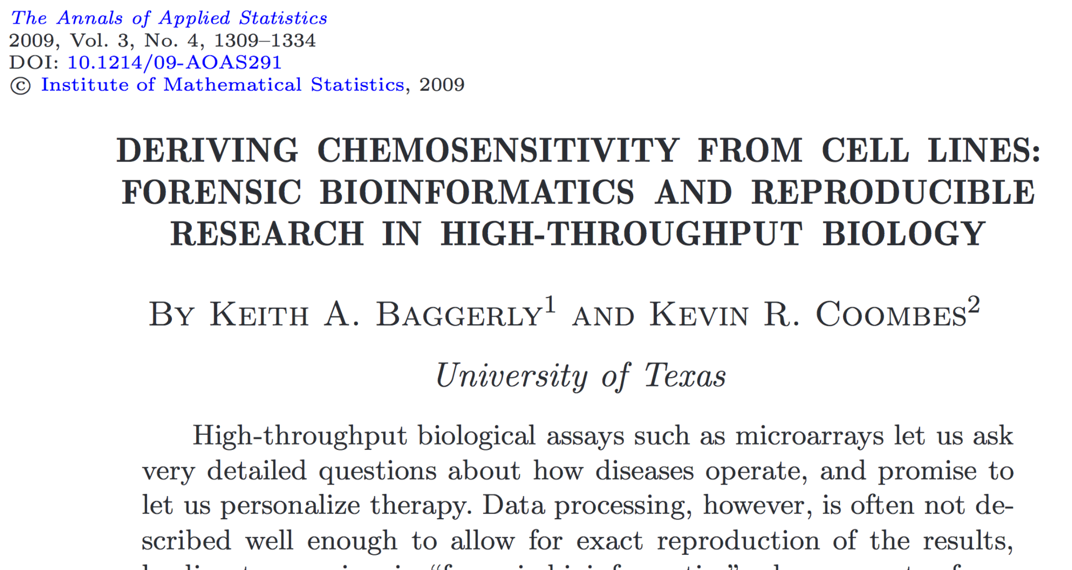

Slide 8
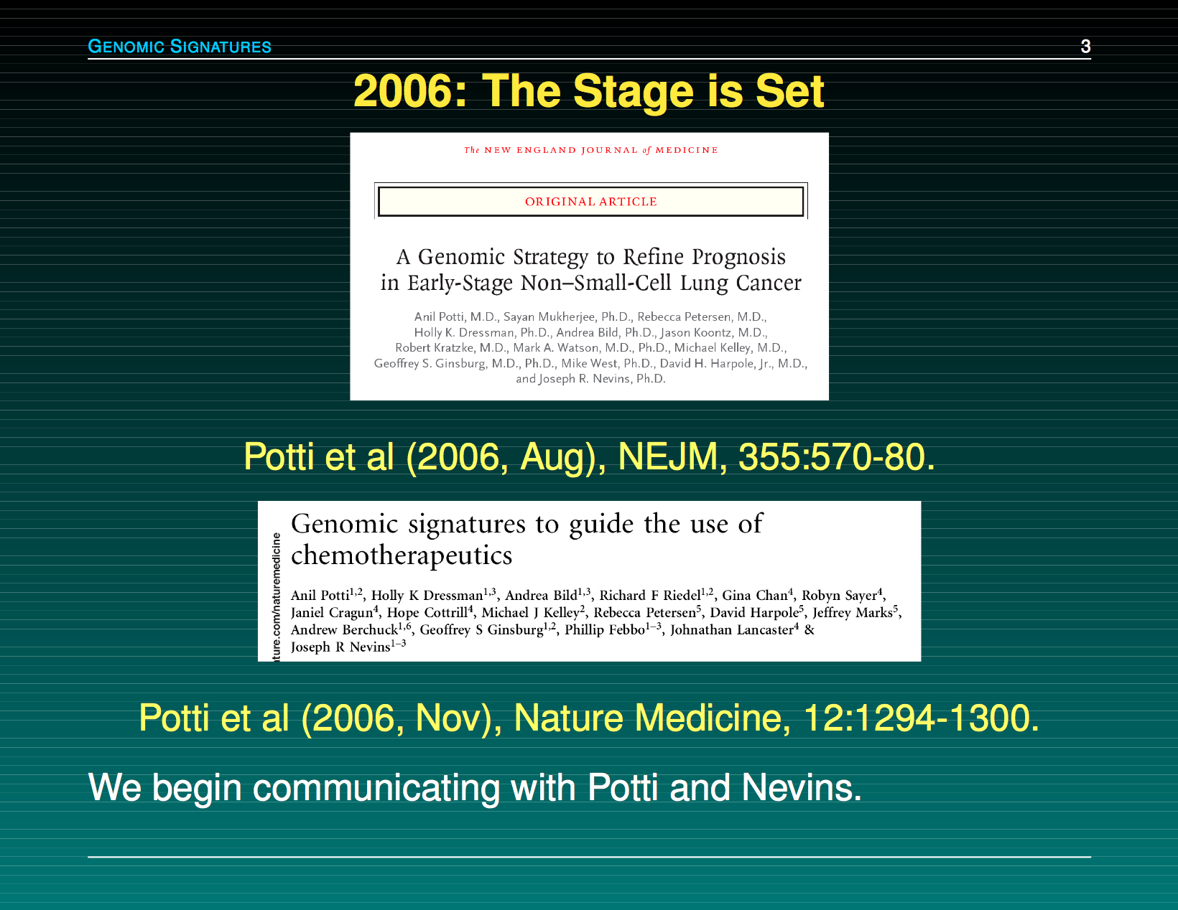

Slide 9
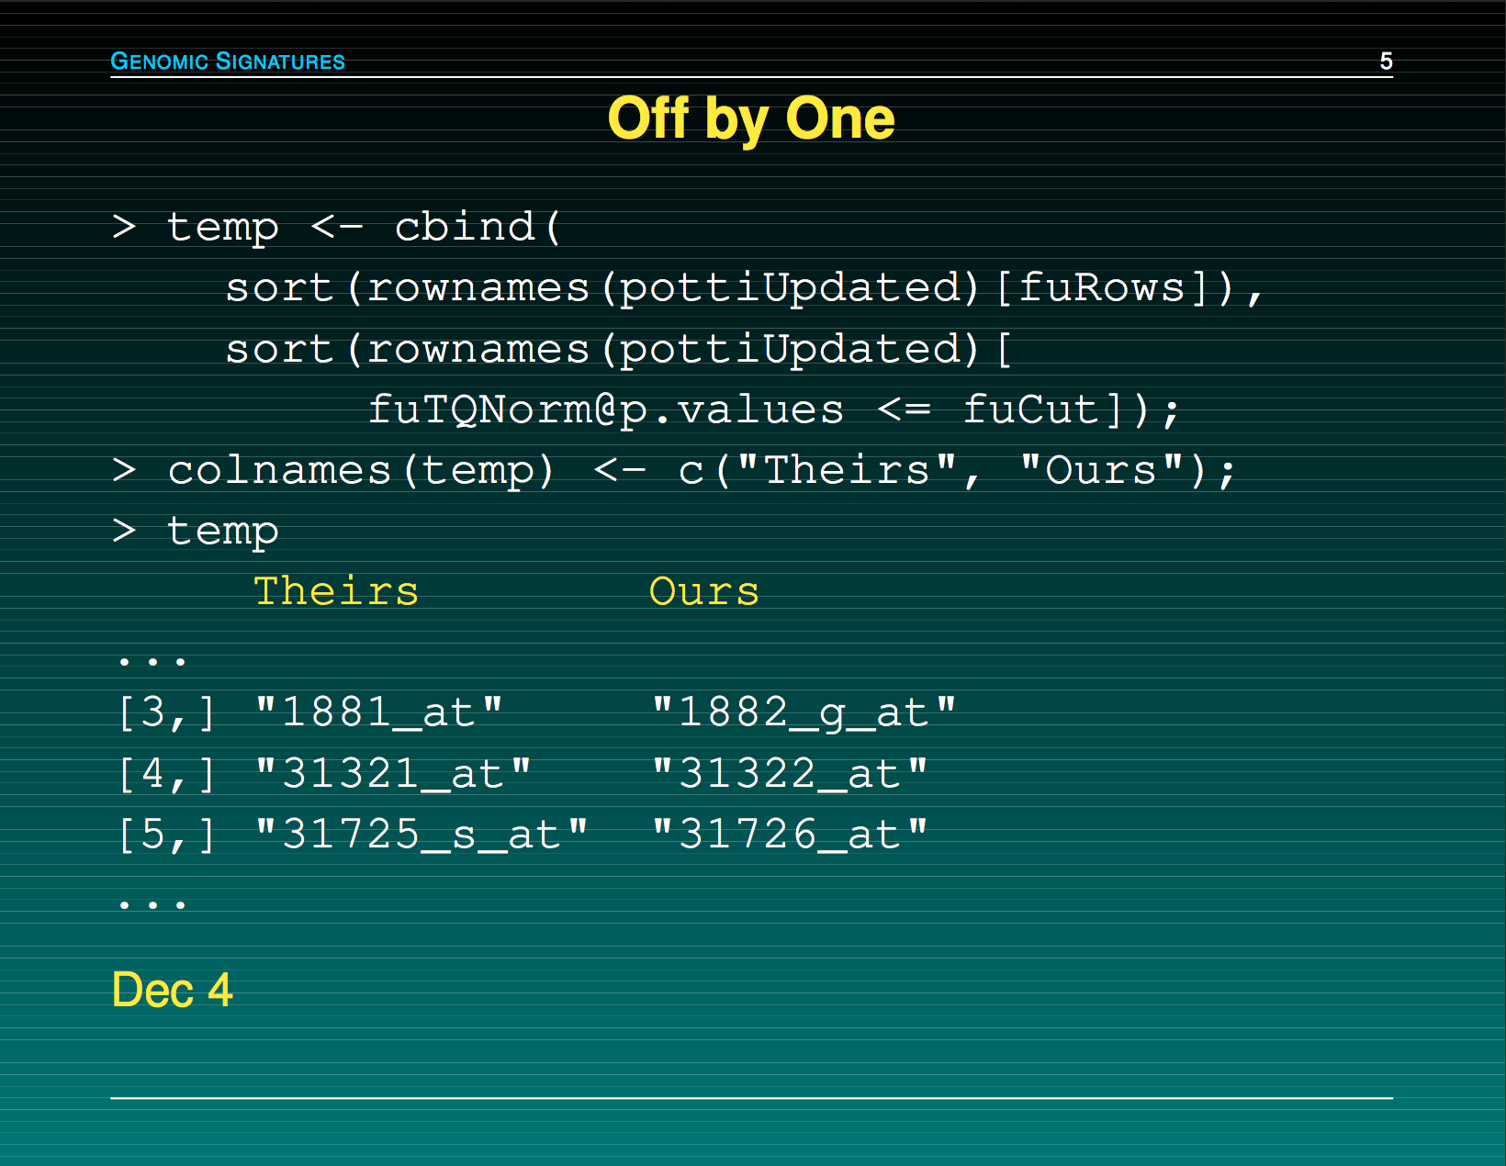

Slide 10
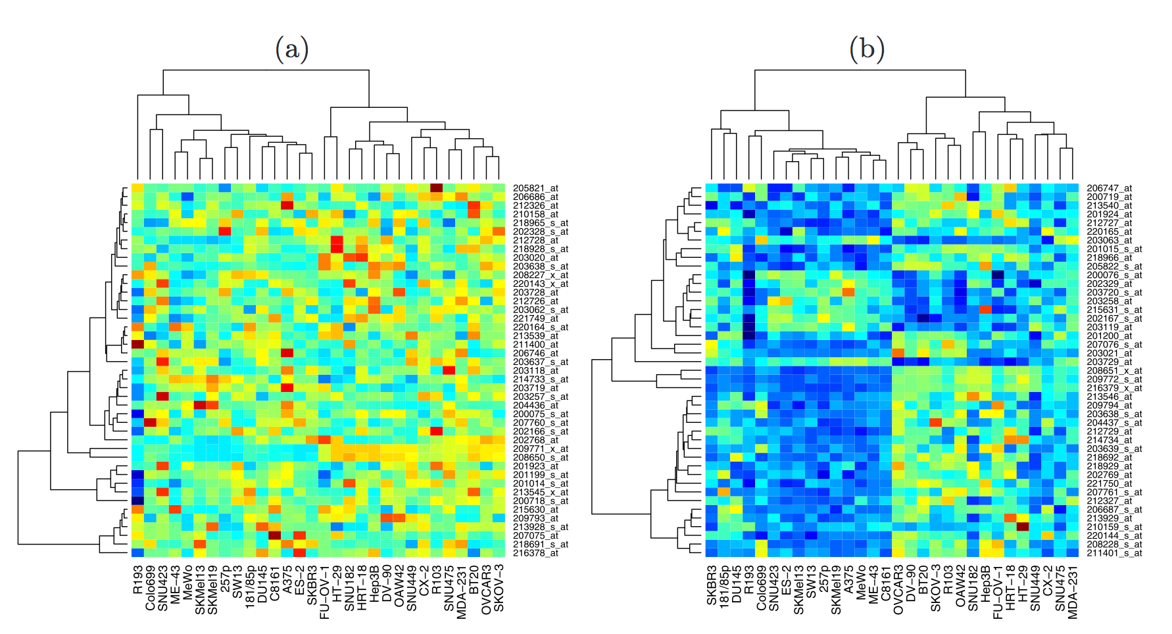
Baggerly & Coombes, AOAS 2009

Slide 11
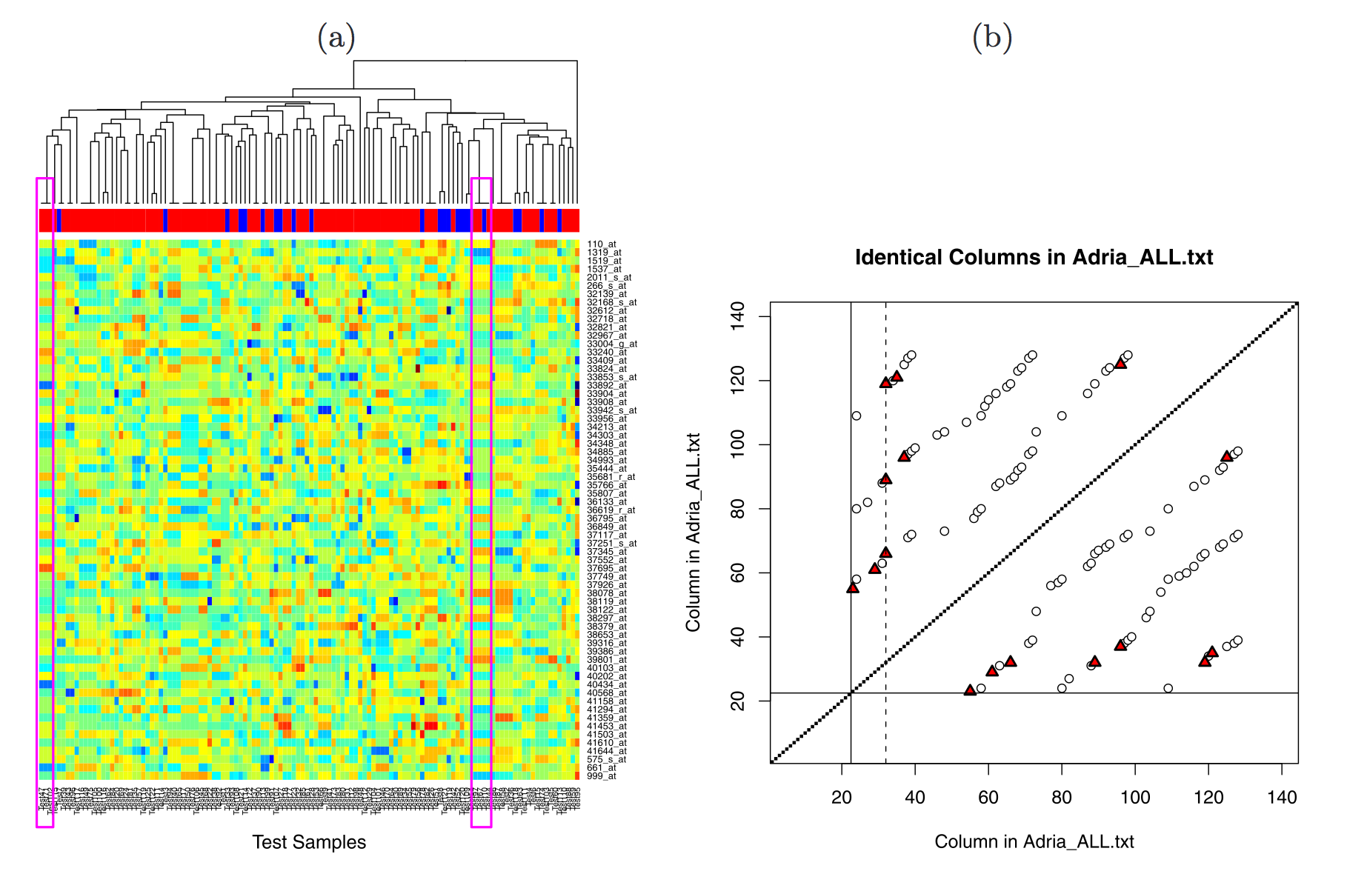
Baggerly & Coombes, AOAS 2009

Slide 12
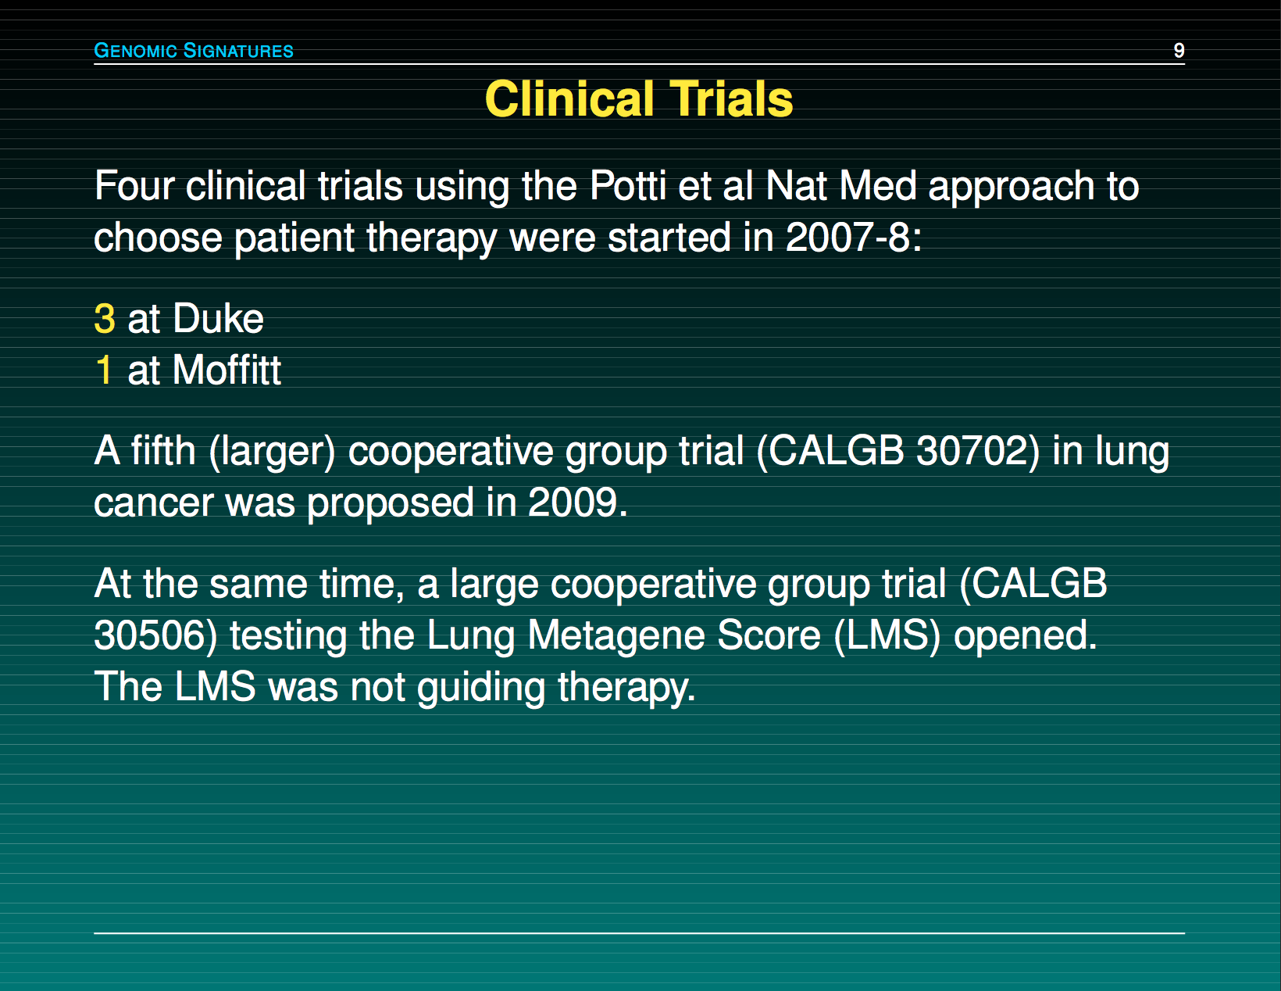

Slide 13
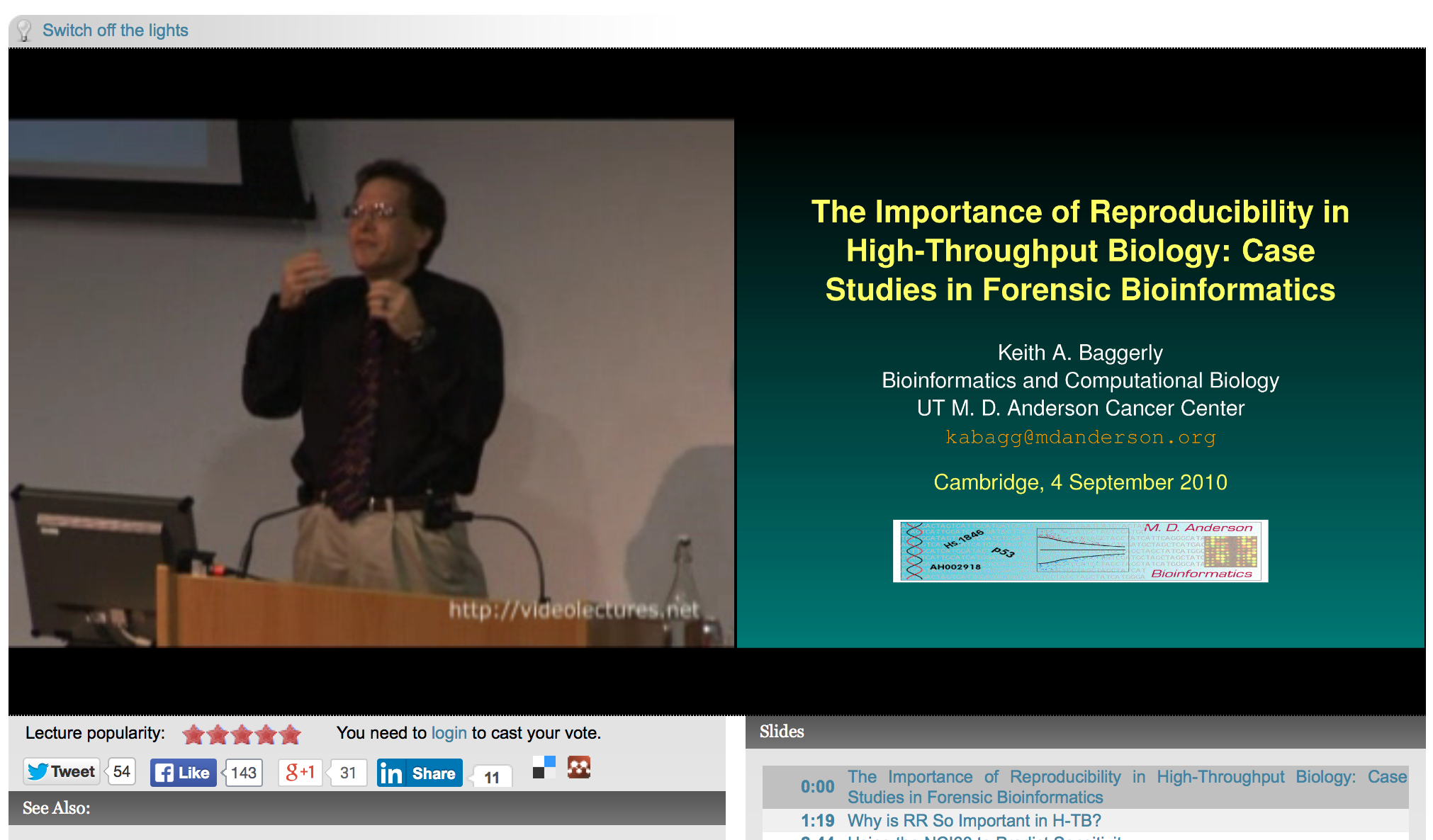
http://videolectures.net/cancerbioinformatics2010_baggerly_irrh/

Slide 14
Reproducibility
0
It’s the right thing to do!
The world would be a better place if everyone did it!
It’s the foundation of Science!
It’s the honourable thing to do!

Slide 15


Slide 16


Slide 17
Reproducibility helps to avoid disaster
1

Slide 18
Anatomy of the NFκB pathway
Step 1
?
Hits
Weak
Phenotype
Strong
NFκB
Step 2
Knock-down
Compare
expression
phenotypes
by NEMs
Known pathway
members
New RNAi Hits

Slide 19
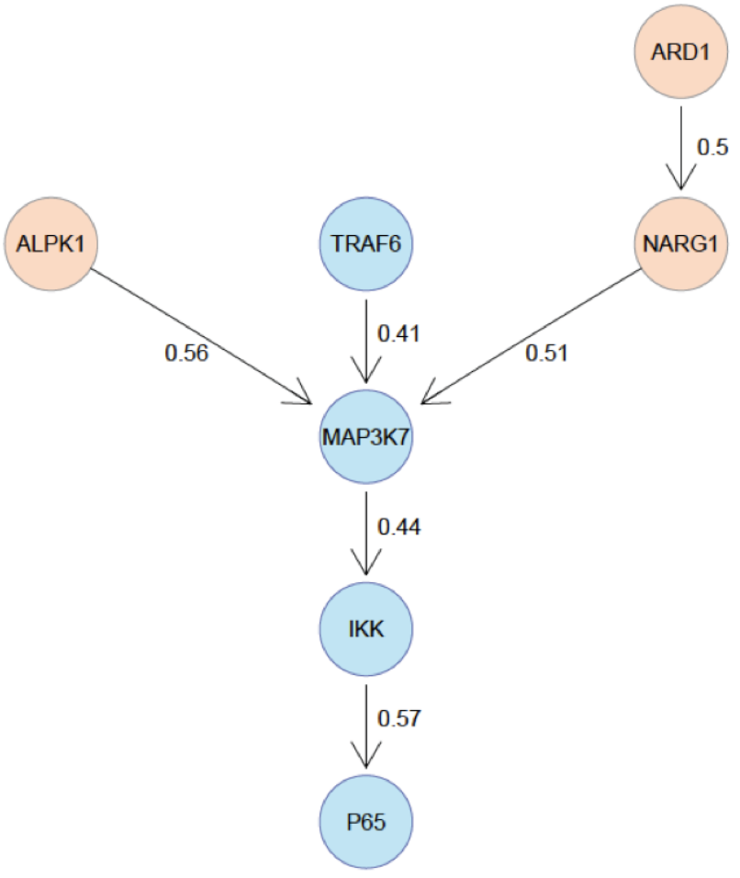
What a nice result!

Slide 20
Reproducibility is engaging
2

Slide 21
Example: grade

Slide 22
Reproducibility enables continuity
3

Slide 23
Going back to your own code can be really tough, even tougher when continuing on others projects

Slide 24
Reproducibility helps arguing with reviewers
4

Slide 25
PLoS Medicine example

Slide 26
Reproducibility increases your standing in the community
5

Slide 28
5 selfish reasons to work reproducibly
Avoid disaster
Makes it easier to engage
Continuity in the lab
Easier to argue with reviewers
Standing in the community

Slide 29
Scientific SOFT SKILLS
\project
\data
\code
\analysis
\paper
Organization of project
Tidy data
Tidy code
Control over tools
Documentation
Reproducibility
Less clicking and pasting,
more scripting and coding

Slide 30
Excuses people make
You should do it, but the effort you put into should be valued by the group you work in and your supervisor.
It takes too long
It should be every postdocs business how to document their work
I can do all this in Excel

Slide 31
When do you need to worry about reproducibility?
Before you start the project
When you do the analysis
When you write the paper
When you co-author a paper
When you review a paper
ALWAYS!

Slide 32
The next two talks
Gordon Brown
Stephen Eglen

Slide 33
If you have a new algorithm or method, mot people make their code available
BUT what I talk about are analysis scripts using ‘standard’ software.

Slide 34
Reproducibility rulez!
Thank you !

